Slide 1
MIS3690 Web Technologies
Babson College
TOIM Division
Fall 2015

Slide 2
Multimedia Objects

Slide 3
Embedding vs. Linking
Linking
Any type of file
But that file becomes the full window
Embedding
Application is embedded in your page
Complicated because app must run inside the browser window in the space you’ve allocated

Slide 4
Linking to a Youtube video
Copy the url and paste it in an <a> tag
<a href="https://www.youtube.com/watch?v=CevxZvSJLk8">Katy Perry - Roar (Official)</a>

Slide 5
Linking to a file
Example:
<a href="file:\\C:\Dropbox\MIS3690_WebTech\Fall2015\ClassSessions\CS10">ppt</a>
Notes:
In server need to use relative path

Slide 6
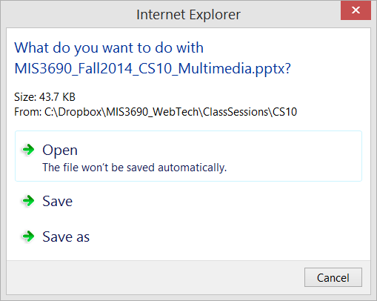
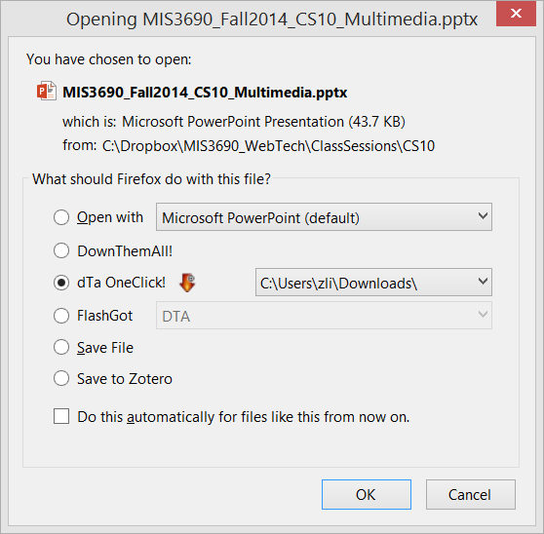
Linking Example – On Run

Slide 7
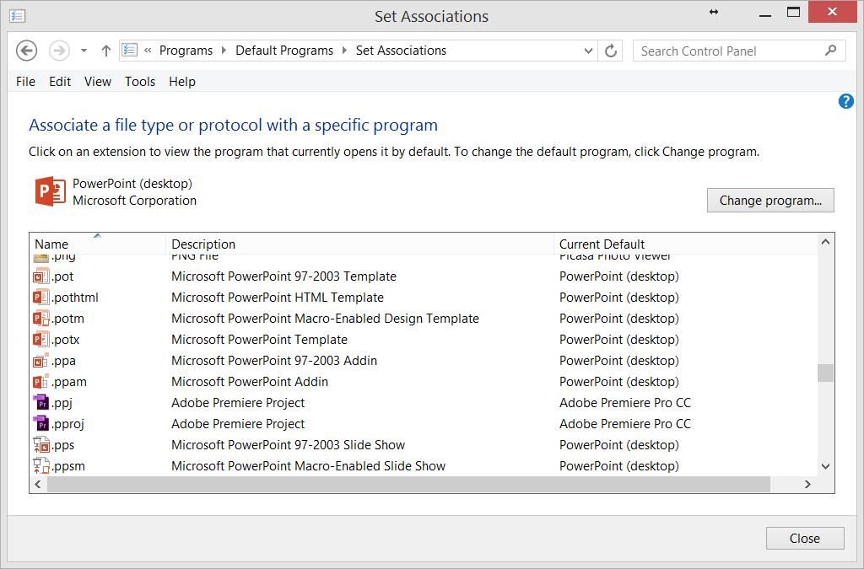
Controlling How Linked File Runs

Slide 8
Embedding Objects
An embedded object runs inside a little window on your page
It can be positioned or floated with styles
Example: a typical YouTube video
There are a variety of tags you can use for this:
<audio>
<video>
<iframe>
<object>
<embed>

Slide 9
<audio> & <video>
New to HTML in HTML5
Intended to replace the need for browser plugins that some users have and others do not
Internet Explorer 9+, Firefox, Opera, Chrome, and Safari support the <audio> and <video> element.

Slide 10
<audio> and <video>
Optional attributes
autoplay="autoplay" (starts on page load)
loop="loop" (plays continuously)
controls="controls" (displays controls)
preload = "auto" (preloads file on page load) or "meta" (just preloads metadata)
src: the url of the source. If not included, you must specify the source with a <source> tag (see next page)
For <video>, height and width
</audio> and </video> are required

Slide 11
The <source> Tag
Provides alternative sources of audio and video between the opening and closing tags.
Example:
<audio autoplay="autoplay"> <source src="mymusic.ogg" type="audio/ogg" /> <source src="mymusic.mp3" type="audio/mpeg" /> Your browser does not support the audio element. </audio>
When multiple source tags exist, first one supported by your browser will be the one used
src attribute provides the url or file name
For type attribute, see next page

Slide 12
Types for the <source> Tag
For video:
For audio:
File Format | Media Type
MP4 | video/mp4
WebM | video/webm
Ogg | video/ogg
File Format | Media Type
MP3 | audio/mpeg
Ogg | audio/ogg
Wav | audio/wav

Slide 13
File Type Conversion
Several free conversion programs exist (see examples below)
http://audio.online-convert.com/convert-to-ogg
http://www.zamzar.com/convert/mp3-to-ogg
Notes:
If you don’t have that format you can easily convert.

Slide 14
<audio> <video> Assessment
Standards are still evolving.
Disagreements exist about whether standard should include only patent-free formats
The wave of the future.
Pundits expect that in two years, all browsers will be compliant and eliminate use of Flash, Quicktime, Real, etc.

Slide 15
The <iframe> Tag
<iframe> creates an inline frame in which another document (perhaps multimedia) can be placed
Works for YouTube videos
In YouTube, click on "Share" and then "Embed"
Copy code
Remove type, allowfullscreen, and frameborder attributes, which are not standard HTML5
To autostart, at end of src="…" before close quote, add &amp;autoplay=1. If the url does not already include a question mark, put a question mark(?) before the & sign.
Notes:
Good for embedding things within web page

Slide 16
Other <iframe> File Types
The following file types will work in an iframe on Firefox, IE 9, Chrome, and Safari
swf
wav
mp3

Slide 17
Embedding a soundcloud audio
<iframe width="50%" scrolling="no" frameborder="no"
src="https://w.soundcloud.com/player/?url=https%3A//api.soundcloud.com/tracks/66424164&amp;auto_play=false&amp;hide_related=false&amp;show_comments=true&amp;show_user=true&amp;show_reposts=false&amp;visual=true">
</iframe>
An embedded object runs inside a little window on your page
Notes:
Go to share→ embed

Slide 18
Embedding Objects
An embedded object runs inside a little window on your page
It can be positioned or floated with styles
To do this you need the tag:
<object> </object>
This tag has attributes
You can also specify "parameters" within the object tag.

Slide 19
Typical Embedded Objects
Movie or recording
Windows media player
QuickTime
Flash
YouTube videos
Mp3

Slide 20
Attributes of <object>
width: specifies the width of the window in which the object is viewed
height: specifies the height of the window in which the object is viewed
type: used to specify the type of multimedia
data: used to specify the file to play/open
classid: a unique attribute used to specify the software for multi-media (Not supported in HTML5.)
and there are more…
Notes:
Youtube does not support objects right now

Slide 21
Object Parameters
Each object type has different parameters that control its function
Parameters are placed between the <object> and </object> tags
Parameter tag:
<param name="name" value="…" />

Slide 22
Example of Parameters
<param name="autostart" value="true" />
Starts the object when the page loads
<param name="URL" value="http://…" />
The URL or the file name where the movie or recording can be found

Slide 23
Embedding a YouTube video
<object width="560" height="315">
<param name="movie" value="http://www.youtube.com/v/PgJQ6LQ8x1E?hl=en_US&amp;version=3"></param>
<param name="allowFullScreen" value="true"></param>
<param name="allowscriptaccess" value="always"></param>
<embed src="http://www.youtube.com/v/PgJQ6LQ8x1E?hl=en_US&amp;version=3" type="application/x-shockwave-flash" width="560" height="315" allowscriptaccess="always" allowfullscreen="true"></embed>
</object>

Slide 24
Embedding flash
Example:
http://www.w3schools.com/html/tryit.asp?filename=tryhtml_object_plugin
Notes:
Swf mean flash

Slide 25
Automatic slideshow
Example: Auto play 4 webpages, tiger1.htm, tiger2.htm, tiger3.htm and tiger4.htm
In page1.html, in the head section, add the following meta tag
<meta http-equiv="refresh" content="5"; url=tiger2.htm" />
content = "n" where n is the number of seconds the page should stay on the screen
url="nextpage.html" where nextpage.html is the next web page to be displayed
After 5 seconds, tiger2.html will automatically be loaded.
In tiger2.htm, in the head section, add the following meta tag
<meta http-equiv="refresh" content="5; url=tiger3.htm" />
After 5 seconds, tiger3.htm will automatically be loaded.
And so on…
Notes:
Embed in head!
Try this for next class!!

